Slide 1
Cursus web development
Dag 1

Slide 2
Introductie
3-daagse cursus basic web development
2 dagen front-end
1 dag back-end
Vandaag
Version Control – GIT
MVC Patroon
Javascript & jQuery

Slide 3
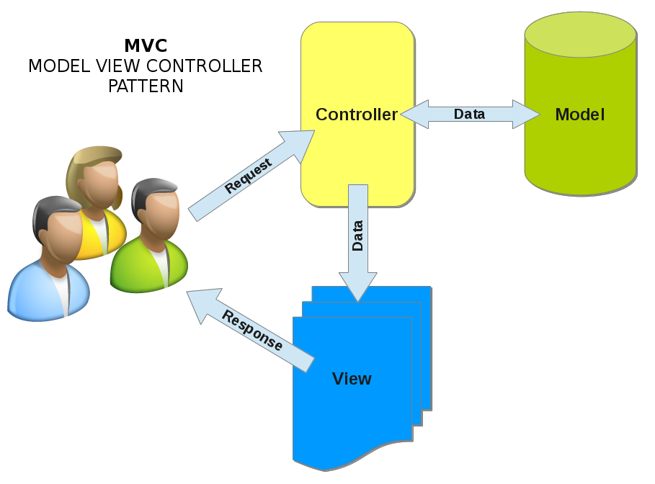
MVC Patroon

Slide 4
Version Control
Wat is “version control”?
Systeem dat veranderingen in bestanden opslaat.
Waarom is het handig?
Bekijk aangebrachte wijzigingen.
Herstel bestanden naar oudere versies.
Bekijk wie wijzigingen heeft aangebracht.
Parallel werken aan projecten/bestanden.
Bestanden kwijt? Geen probleem!
Notes:
What is "version control", and why should you care? Version control is a system that records changes to a file or set of files over time so that you can recall specific versions later. For the examples in this book you will use software source code as the files being version controlled, though in reality you can do this with nearly any type of file on a computer.
If you are a graphic or web designer and want to keep every version of an image or layout (which you would most certainly want to), a Version Control System (VCS) is a very wise thing to use. It allows you to revert files back to a previous state, revert the entire project back to a previous state, compare changes over time, see who last modified something that might be causing a problem, who introduced an issue and when, and more. Using a VCS also generally means that if you screw things up or lose files, you can easily recover. In addition, you get all this for very little overhead.

Slide 5
Version Control - Local
Lokale database waarin wijzigingen worden opgeslagen.
Nadelen:
Niet mogelijk om met andere developers samen te werken.
Single point of failure.
Notes:
Many people’s version-control method of choice is to copy files into another directory (perhaps a time-stamped directory, if they’re clever). This approach is very common because it is so simple, but it is also incredibly error prone. It is easy to forget which directory you’re in and accidentally write to the wrong file or copy over files you don’t mean to.
To deal with this issue, programmers long ago developed local VCSs that had a simple database that kept all the changes to files under revision control.

Slide 6
Version Control - Centralized
Centrale database waarin wijzigingen worden opgeslagen. Bijv. CVS & Subversion.
Voordelen:
Samenwerken met andere developers.
Nadelen:
Single point of failure.
Notes:
The next major issue that people encounter is that they need to collaborate with developers on other systems. To deal with this problem, Centralized Version Control Systems (CVCSs) were developed. These systems, such as CVS, Subversion, and Perforce, have a single server that contains all the versioned files, and a number of clients that check out files from that central place. For many years, this has been the standard for version control.
This setup offers many advantages, especially over local VCSs. For example, everyone knows to a certain degree what everyone else on the project is doing. Administrators have fine-grained control over who can do what; and it’s far easier to administer a CVCS than it is to deal with local databases on every client.
However, this setup also has some serious downsides. The most obvious is the single point of failure that the centralized server represents. If that server goes down for an hour, then during that hour nobody can collaborate at all or save versioned changes to anything they’re working on. If the hard disk the central database is on becomes corrupted, and proper backups haven’t been kept, you lose absolutely everything – the entire history of the project except whatever single snapshots people happen to have on their local machines. Local VCS systems suffer from this same problem – whenever you have the entire history of the project in a single place, you risk losing everything.

Slide 7
Version Control - Distributed
Clients & server beschikken over de volledige repository. Bijv. GIT & Mercurial.
Voordelen:
Iedereen beschikt over een backup van de repository.
Tegelijkertijd samenwerken met meerdere mensen aan verschillende projecten.
Notes:
This is where Distributed Version Control Systems (DVCSs) step in. In a DVCS (such as Git, Mercurial, Bazaar or Darcs), clients don’t just check out the latest snapshot of the files: they fully mirror the repository. Thus if any server dies, and these systems were collaborating via it, any of the client repositories can be copied back up to the server to restore it. Every clone is really a full backup of all the data.
Furthermore, many of these systems deal pretty well with having several remote repositories they can work with, so you can collaborate with different groups of people in different ways simultaneously within the same project. This allows you to set up several types of workflows that aren’t possible in centralized systems, such as hierarchical models.

Slide 8
GIT - Introductie
Voor het eerst uitgebracht in 2005.
Ontwikkeld door de Linux community.
Kenmerken:
Snel
Simpel design
Sterke ondersteuning voor parallel development.
Volledig distributed
Kan efficiënt omgaan met grote project zoals de Linux kernel.
Notes:
As with many great things in life, Git began with a bit of creative destruction and fiery controversy.
The Linux kernel is an open source software project of fairly large scope. For most of the lifetime of the Linux kernel maintenance (1991–2002), changes to the software were passed around as patches and archived files. In 2002, the Linux kernel project began using a proprietary DVCS called BitKeeper.
In 2005, the relationship between the community that developed the Linux kernel and the commercial company that developed BitKeeper broke down, and the tool’s free-of-charge status was revoked. This prompted the Linux development community (and in particular Linus Torvalds, the creator of Linux) to develop their own tool based on some of the lessons they learned while using BitKeeper. Some of the goals of the new system were as follows:
Speed
Simple design
Strong support for non-linear development (thousands of parallel branches)
Fully distributed
Able to handle large projects like the Linux kernel efficiently (speed and data size)
Since its birth in 2005, Git has evolved and matured to be easy to use and yet retain these initial qualities. It’s incredibly fast, it’s very efficient with large projects, and it has an incredible branching system for non-linear development

Slide 9
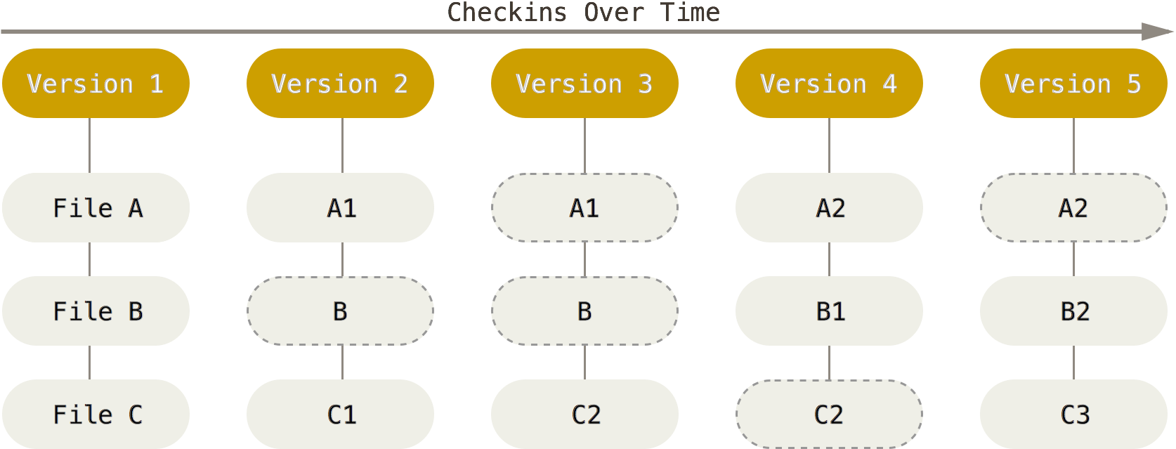
GIT - Basics
Snapshots, geen aanpassingen
Notes:
The major difference between Git and any other VCS (Subversion and friends included) is the way Git thinks about its data. Conceptually, most other systems store information as a list of file-based changes. These systems (CVS, Subversion, Perforce, Bazaar, and so on) think of the information they keep as a set of files and the changes made to each file over time.
Git doesn’t think of or store its data this way. Instead, Git thinks of its data more like a set of snapshots of a miniature filesystem. Every time you commit, or save the state of your project in Git, it basically takes a picture of what all your files look like at that moment and stores a reference to that snapshot. To be efficient, if files have not changed, Git doesn’t store the file again, just a link to the previous identical file it has already stored. Git thinks about its data more like a stream of snapshots.
This is an important distinction between Git and nearly all other VCSs. It makes Git reconsider almost every aspect of version control that most other systems copied from the previous generation. This makes Git more like a mini filesystem with some incredibly powerful tools built on top of it, rather than simply a VCS. We’ll explore some of the benefits you gain by thinking of your data this way when we cover Git branching in Git Branching.

Slide 10
GIT - Basics
Bijna elke operatie gebeurt lokaal
Project geschiedenis wordt lokaal opgeslagen.
Het is niet mogelijk een bestand aan te passen zonder dat GIT het weet.
GIT voegt alleen data toe. Het is moeilijk om data te verwijderen.
Notes:
Nearly Every Operation Is Local
Most operations in Git only need local files and resources to operate – generally no information is needed from another computer on your network. If you’re used to a CVCS where most operations have that network latency overhead, this aspect of Git will make you think that the gods of speed have blessed Git with unworldly powers. Because you have the entire history of the project right there on your local disk, most operations seem almost instantaneous.
For example, to browse the history of the project, Git doesn’t need to go out to the server to get the history and display it for you – it simply reads it directly from your local database. This means you see the project history almost instantly. If you want to see the changes introduced between the current version of a file and the file a month ago, Git can look up the file a month ago and do a local difference calculation, instead of having to either ask a remote server to do it or pull an older version of the file from the remote server to do it locally.
This also means that there is very little you can’t do if you’re offline or off VPN. If you get on an airplane or a train and want to do a little work, you can commit happily until you get to a network connection to upload. If you go home and can’t get your VPN client working properly, you can still work. In many other systems, doing so is either impossible or painful. In Perforce, for example, you can’t do much when you aren’t connected to the server; and in Subversion and CVS, you can edit files, but you can’t commit changes to your database (because your database is offline). This may not seem like a huge deal, but you may be surprised what a big difference it can make.
Git Has Integrity
Everything in Git is check-summed before it is stored and is then referred to by that checksum. This means it’s impossible to change the contents of any file or directory without Git knowing about it. This functionality is built into Git at the lowest levels and is integral to its philosophy. You can’t lose information in transit or get file corruption without Git being able to detect it.
The mechanism that Git uses for this checksumming is called a SHA-1 hash. This is a 40-character string composed of hexadecimal characters (0–9 and a–f) and calculated based on the contents of a file or directory structure in Git. A SHA-1 hash looks something like this:
24b9da6552252987aa493b52f8696cd6d3b00373 You will see these hash values all over the place in Git because it uses them so much. In fact, Git stores everything in its database not by file name but by the hash value of its contents.
Git Generally Only Adds Data
When you do actions in Git, nearly all of them only add data to the Git database. It is hard to get the system to do anything that is not undoable or to make it erase data in any way. As in any VCS, you can lose or mess up changes you haven’t committed yet; but after you commit a snapshot into Git, it is very difficult to lose, especially if you regularly push your database to another repository.
This makes using Git a joy because we know we can experiment without the danger of severely screwing things up. For a more in-depth look at how Git stores its data and how you can recover data that seems lost, see Undoing Things.

Slide 11
GIT - States
Comitted
data opgeslagen in locale db.
Modified
onopgeslagen wijzigingen.
Staged
wordt opgenomen in volgende commit.

Slide 12
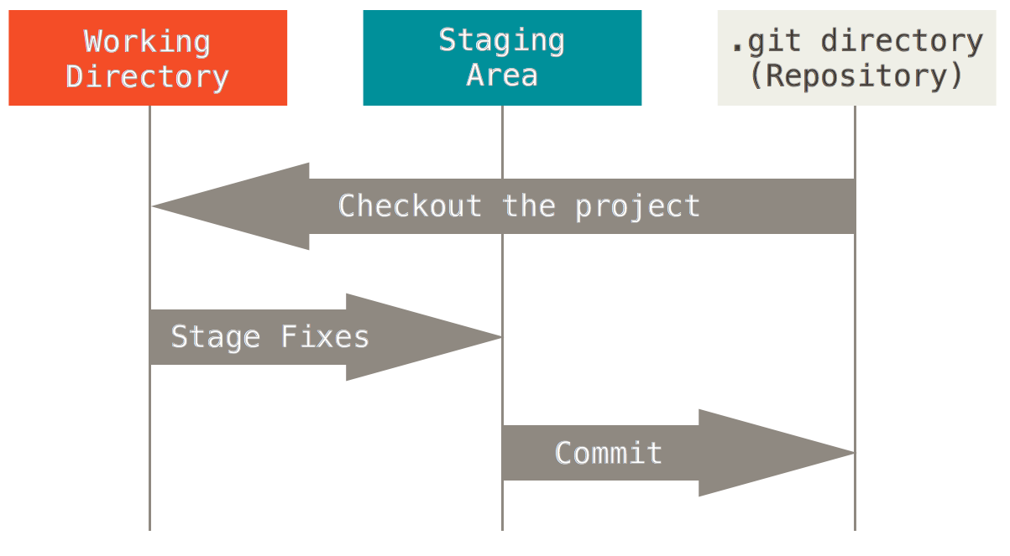
GIT - Workflow
Notes:
The Three States
Now, pay attention. This is the main thing to remember about Git if you want the rest of your learning process to go smoothly. Git has three main states that your files can reside in: committed, modified, and staged. Committed means that the data is safely stored in your local database. Modified means that you have changed the file but have not committed it to your database yet. Staged means that you have marked a modified file in its current version to go into your next commit snapshot.
This leads us to the three main sections of a Git project: the Git directory, the working directory, and the staging area.
The Git directory is where Git stores the metadata and object database for your project. This is the most important part of Git, and it is what is copied when you clone a repository from another computer.
The working directory is a single checkout of one version of the project. These files are pulled out of the compressed database in the Git directory and placed on disk for you to use or modify.
The staging area is a file, generally contained in your Git directory, that stores information about what will go into your next commit. It’s sometimes referred to as the “index”, but it’s also common to refer to it as the staging area.
The basic Git workflow goes something like this:
You modify files in your working directory.
You stage the files, adding snapshots of them to your staging area.
You do a commit, which takes the files as they are in the staging area and stores that snapshot permanently to your Git directory.
If a particular version of a file is in the Git directory, it’s considered committed. If it has been modified and was added to the staging area, it is staged. And if it was changed since it was checked out but has not been staged, it is modified. In Git Basics, you’ll learn more about these states and how you can either take advantage of them or skip the staged part entirely.

Slide 13
GIT – Aan de slag
https://try.github.io/levels/1/challenges/1

Slide 14
GIT - Opdrachten
Opdracht 1 - TODO
Opdracht 2 - TODO

Slide 15
Javascript - Introductie
Javascript maakt web pagina’s interactief
Verschaft toegang tot DOM elementen.
Aanpassen van content.
Toevoegen van logica.
Reageren op events.

Slide 16
Javascript – Variabelen
var quantity;
quantity = 10;
Data types
Numeriek
String
Boolean

Slide 17
Javascript - Array
var colors;
colors = [‘wit’, ‘oranje’, ‘groen’];
var c = colors[1]; //Wat is c?
var l = colors.length;

Slide 18
Javascript - Functies
Named functions
Kan worden aangeroepen voordat de functie is gedeclareerd.
helloWorld();
function helloWorld() {
console.log(‘Hello world’);
}

Slide 19
Javascript - Functies
Anononieme functies
Kunnen niet worden aangeroepen voordat de functie is gedeclareerd.
var area = function (width, height) {
return width * height;
}
var size = area(2,4);

Slide 20
Javascript - Functies
Immediately Invoked Function Expressions (IIFE)
Wordt gebruikt als wrapper voor een set code. Voorkomt naming collisions. Iets met scope. MUSTAFA
var area = (function() {
return 2 * 3;
}())

Slide 21
Javascript - Scope

Slide 22
Javascript - Objecten

Slide 23
Javascript – this keyword

Slide 24
Javascript - opdrachten
Opdracht 1 - Fibonacci

Slide 25
Typescript - Introductie

